Slide 1
Cz1115 FS1 GRoup 13 :
stock prediction
By tan zong wei, wu rongxi & tam kai feng
Using Machine Learning
Using Machine Learning

Slide 2
Problem Statement
Can machine learning can be used to predict the movement of stock prices?

Slide 3
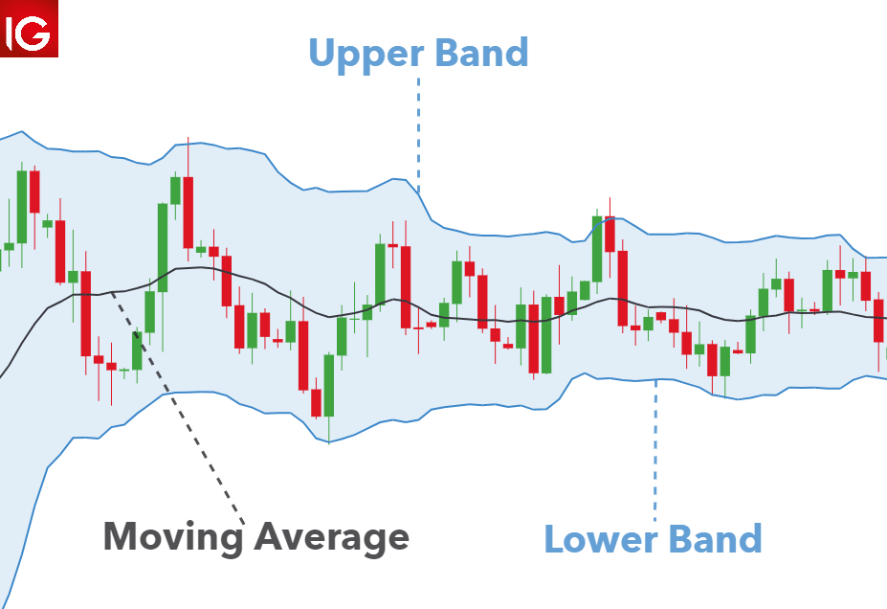
BOLLINGER BANDS

Slide 4
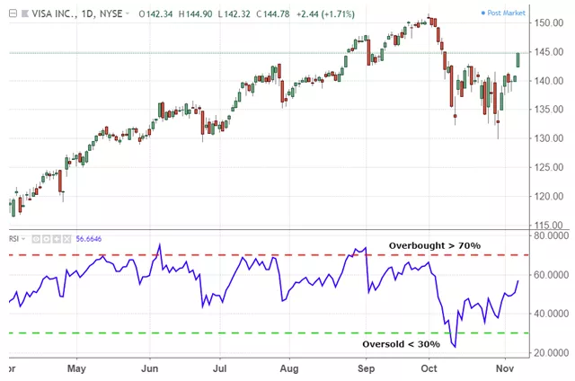
Relative Strength index

Slide 5
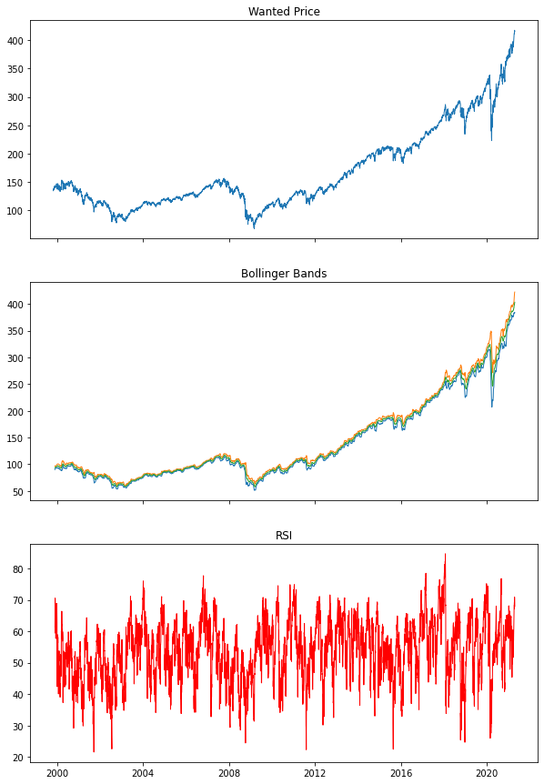
WHOA!
RSI
Data Visualisation
SPY Closing Price
Bollinger Bands

Slide 6
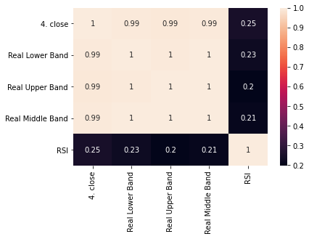
Correlation Heatmap

Slide 7
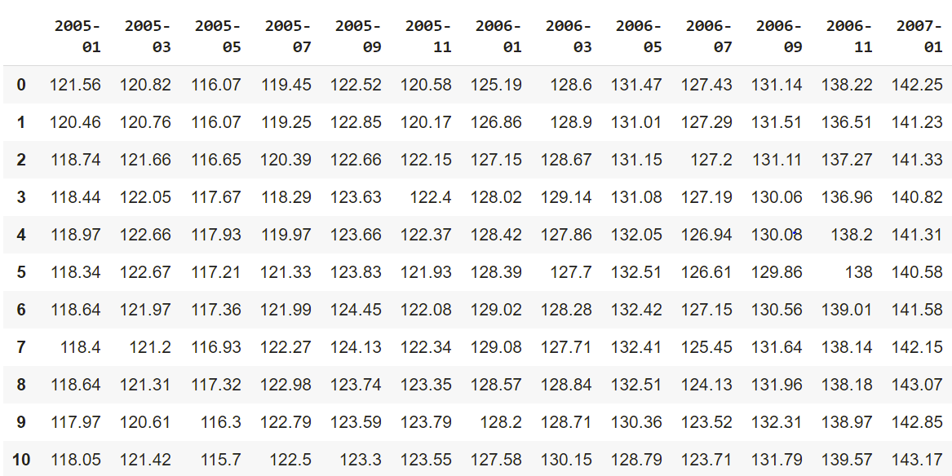
Data Curation
—someone famous

Slide 8
SLIDING WINDOW CONCEPT

Slide 9
SLIDING WINDOW CONCEPT

Slide 10
SLIDING WINDOW CONCEPT

Slide 11
SLIDING WINDOW CONCEPT

Slide 12
SLIDING WINDOW CONCEPT

Slide 13
trying out various Machine Learning techniques and various combinations of variables
Decision Tree Regressor
Linear Regression
Polynomial Regression

Slide 14
We eventually picked:
Linear regression

Slide 15
Simulation and backtesting
If predicted price > current price, buy.
Sell on the actual day 2 months later.
Record profits/losses.
Repeat over the sliding window.

Slide 16
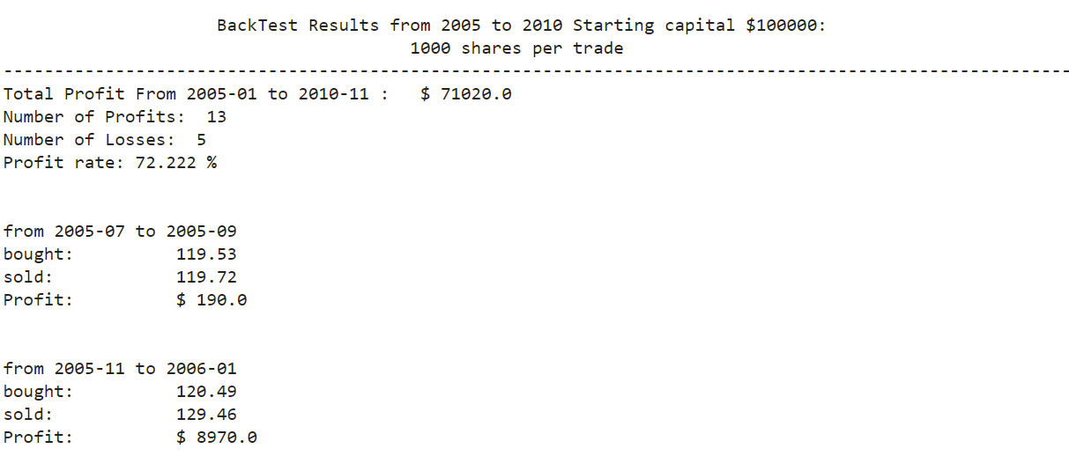

RESULTS

Slide 17
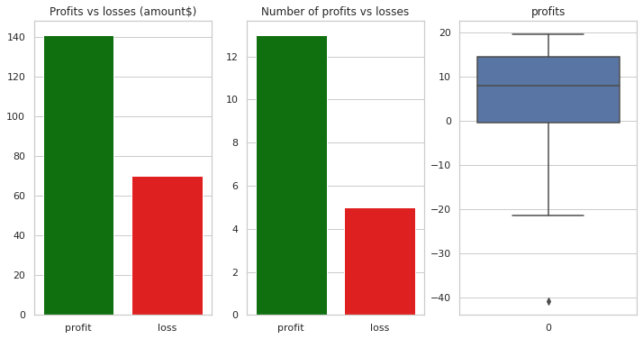
VISUALISATION of the results

Slide 18
DECENT PREDICTI NS

Slide 19

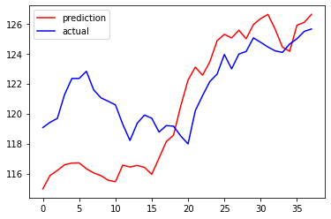
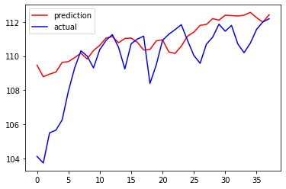
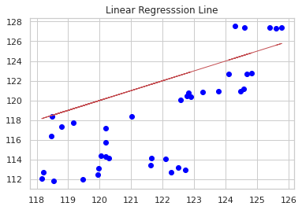
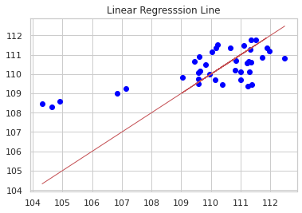

Slide 20
BAD PREDICTIONS

Slide 21
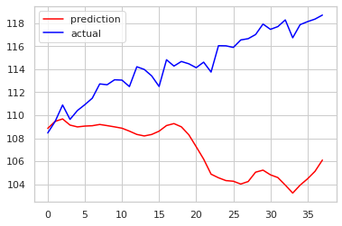
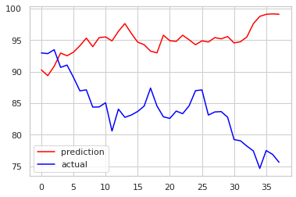
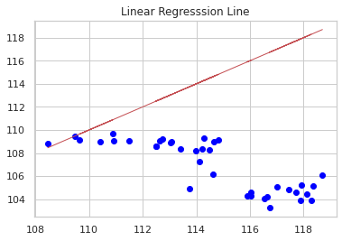
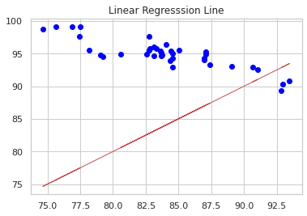

Slide 22
Conclusion
While our stock prediction model is able:
Capture the trends
Prediction the DIRECTION of the stock movements pretty well.

Slide 23
Conclusion
The amount of false positives is Low, probability of making profits is relatively high
The model only generates a Buy signal if the predicted future price is higher than current price.

Slide 24
Conclusion
Based on our observations, our model gave positive results most of the time except when there are sudden drastic changes in market movement.

Slide 25
further improvements
Utilising LSTM Based Neural Networks
Deep Learning models
A larger dataset across various stocks
Including fundamental data.
Reducing False Negatives and maybe include sell positions

Slide 26
Contributions
ZONG WEI | RONGXI | KAI FENG
Sliding window implementation Ideation and concept Data visualisation and Regression modelling Data curation Backtesting | Linear Regression Modelling Data Extraction using API Presentation Slides and project flow User input and output interface | Assistance in Data curation

Slide 27
THANK YOU

Slide 28
IMAGE REFERENCES
https://www.dailyfx.com/education/bollinger-bands/forex-trading.html
https://www.investopedia.com/terms/r/rsi.asp

